Slide 1


          University of Diyala
          College of Engineering
          Department of Electronics Engineering
Course Number: U103
Course Name: Computer Networks
Lecture (5)
Asst. Lect. Ahmed Mohammed Ahmed

Slide 2
RS232C and RS449
Equipment Types
Network equipment may be classified into three broad categories:
Data Terminal Equipment (DTE) refers to user equipment that converts outgoing user data into a transmission signal, and converts back the incoming signal into user data.
Data Circuit-terminating Equipment (DCE) refers to the network equipment that connects DTEs to the network communication lines. In general, a DTE and a network line may use different types of signals (e.g., electrical versus optical). The necessary signal conversion between these two is performed by the DCE. A DCE may be a part of a DTE or be an entirely separate device. Modems and multiplexers are all examples of DCEs.
Data Switching Equipment (DSE) refers to network equipment used to connect DCEs together, thus providing switching capability to the network. DSEs correspond to the nodes in a network, and are responsible for routing data across the network. A DSE is commonly referred to as a switch.

Slide 3
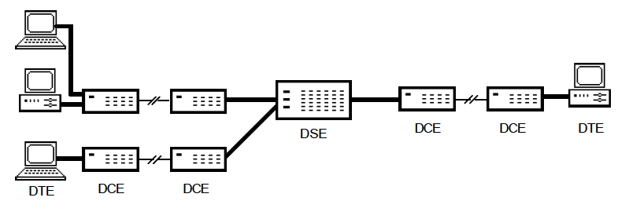

Slide 4
Interface Specifications
The serial port interface for connecting two devices is specified by the TIA (Telecommunications Industry Association) / EIA-232C (Electronic Industries Alliance) standard published by the Telecommunications Industry Association; both the physical and electrical characteristics of the interfaces have been detailed in these publications. RS-232, RS-422, RS-423 and RS-485 are each a recommended standard (RS-XXX) of the Electronic Industry Association (EIA) for asynchronous serial communication and have more recently been rebranded as EIA-232, EIA-422, EIA-423 and EIA-485.

Slide 5
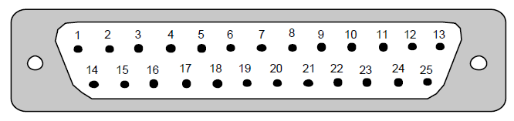
ISO 2110 defines the mechanical appearance of the RS-232 connectors (see Figure 2). The connector provides 25 pins for connecting the circuits derived from the V.24 standard. The circuits are used for data transfer, conveying of control signals, and conveying of clocking signals for synchronization.
V.28 defines the electrical characteristics of RS-232. V.28 uses 5 to 15 Volts to represent binary value 0, and -5 to -15 Volts to represent binary value 1. It allows for connection distances of up to 20 meters and data rates of up to 20 kbps.

Slide 6
Background:
RS-232 is designed for a unidirectional half-duplex communications mode. That simply means that a transmitter (driver) is feeding the data to a receiver over a copper line. The data always follows the direction from driver to receiver over that line. If return transmission is desired, another set of driver- receiver pair and separate wires are needed. In other words, if bi-directional or full-duplex capabilities are needed, two separate communications paths are required.

Slide 7
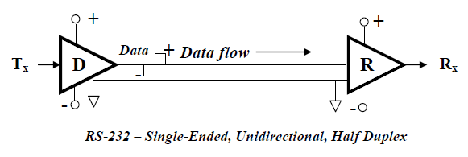

Slide 8
RS-449 interface standard (November 1977)
RS-449 was the intended successor to the functional portion of RS-232. It defined a mechanical specification for plugs and sockets based on a 37-pin and 9-pin assembly. Apart from its improved speed and distance specification, it also offered a number of enhancements such as the provision for automatic modem testing, new grounding arrangements and a number of new signals. Little support was given to RS-449 because of the popularity of RS-232. One problem was that the 37- and 9-pin connectors were not commonly used in the RS-232 domain. In recent years, RS-449 has gained support from the users of RS-422 and RS-485 whose standards do not specify any mechanical connectors. (Refer to Table 3.5 for pin outs). RS-449 has now been superseded by RS/TIA 530-A.

Slide 9
